Slide 1
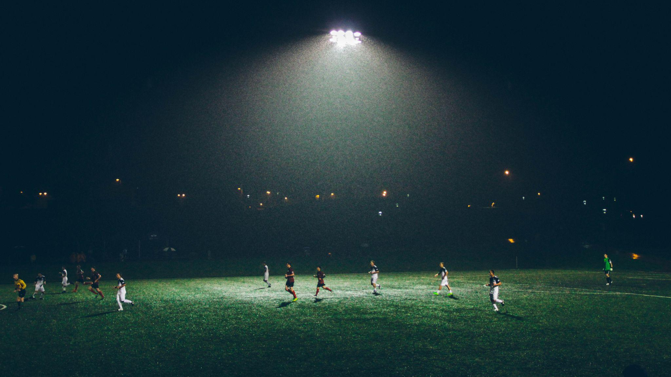
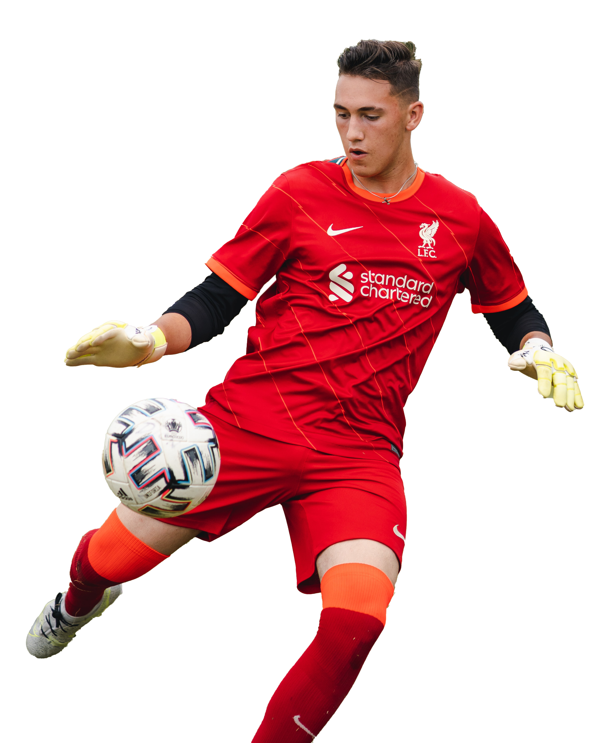

OFFSIDE DETECTION
Group 15
Kareem Albeetar - 101448256
Chun Lam Cheung - 101471424
Eltigani Hamadelniel - 101440790
Yi Liu - 101493612

Slide 2
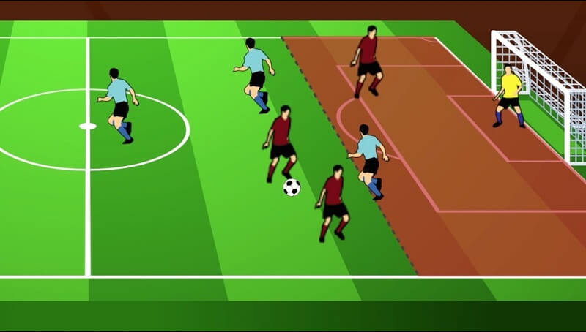
INTRODUCTION
What is offside and why is it important?
The red player (Player A) is in an offside position because they are closer to the opposing goal-line than both the ball and the last defending player (Player B) exclude the Goalkeeper.
If Player A receives the ball in this position, it would result in an indirect free-kick for the opposing team.
Attacking advantage
A
B

Slide 3

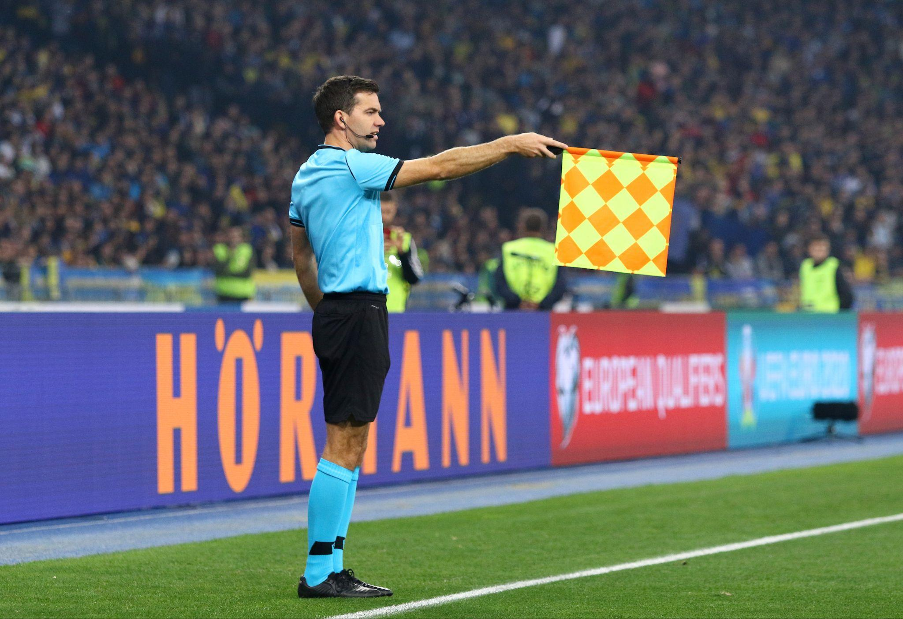

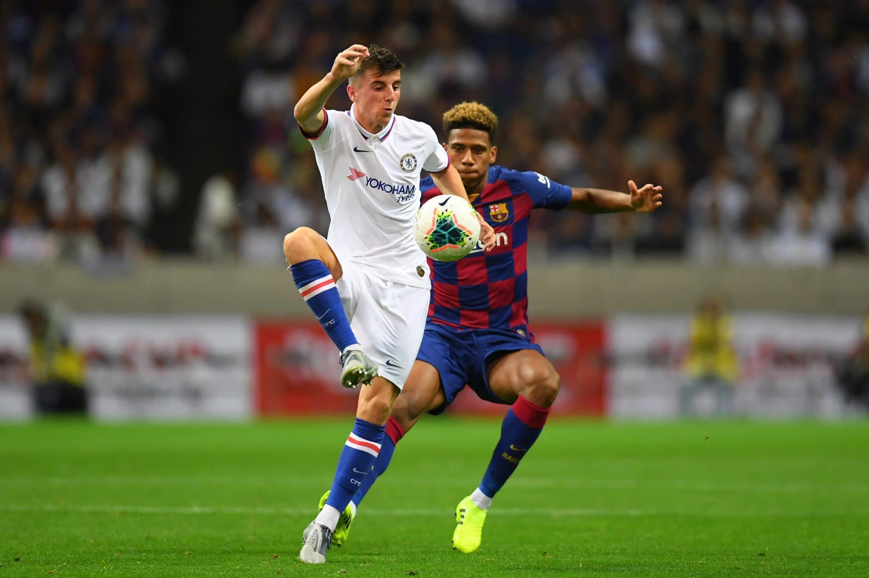
SIGNIFICANCE
1
FAIRNESS & INTEGRITY
Wrong offside calls hurts the integrity of the game. Uncalled offside plays provide an unfair advantage to the attacking team.
LOSS OF FAN ENGAGEMENT & VIEWERSHIP
Minimize controversy by providing objective and precise judgments, based on technology rather than human interpretation.
2
REVENUE & SPONSORSHIPS
Dips in fan engagement as a result of inaccurate offside calls will result in lower pay-per-view sales and match ticket sales leading in a loss of revenue for both clubs and leagues.
3

Slide 4
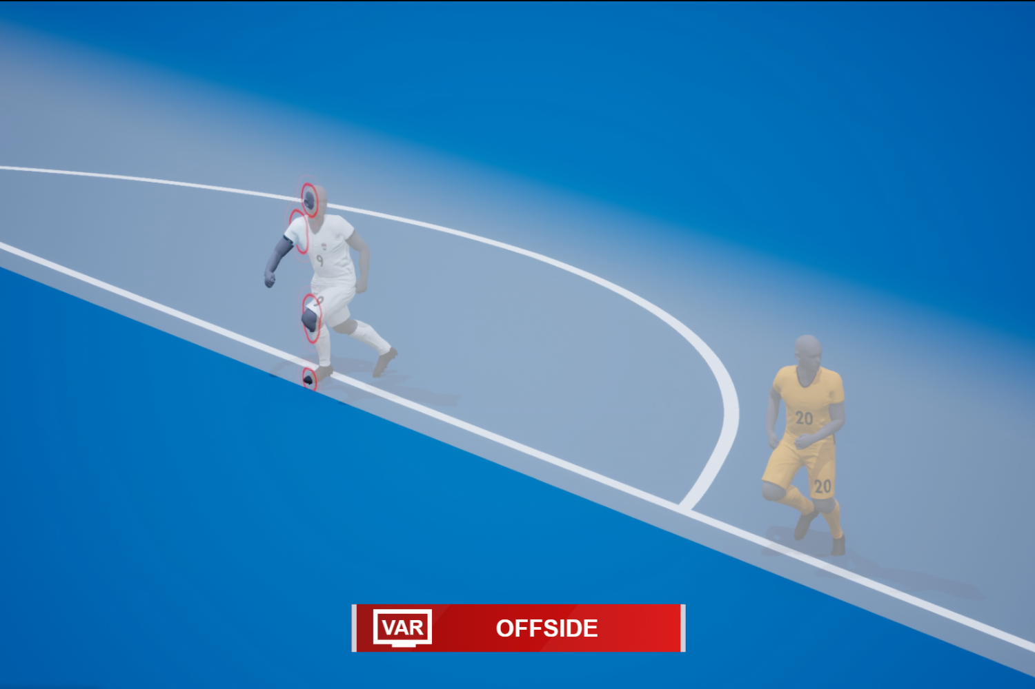
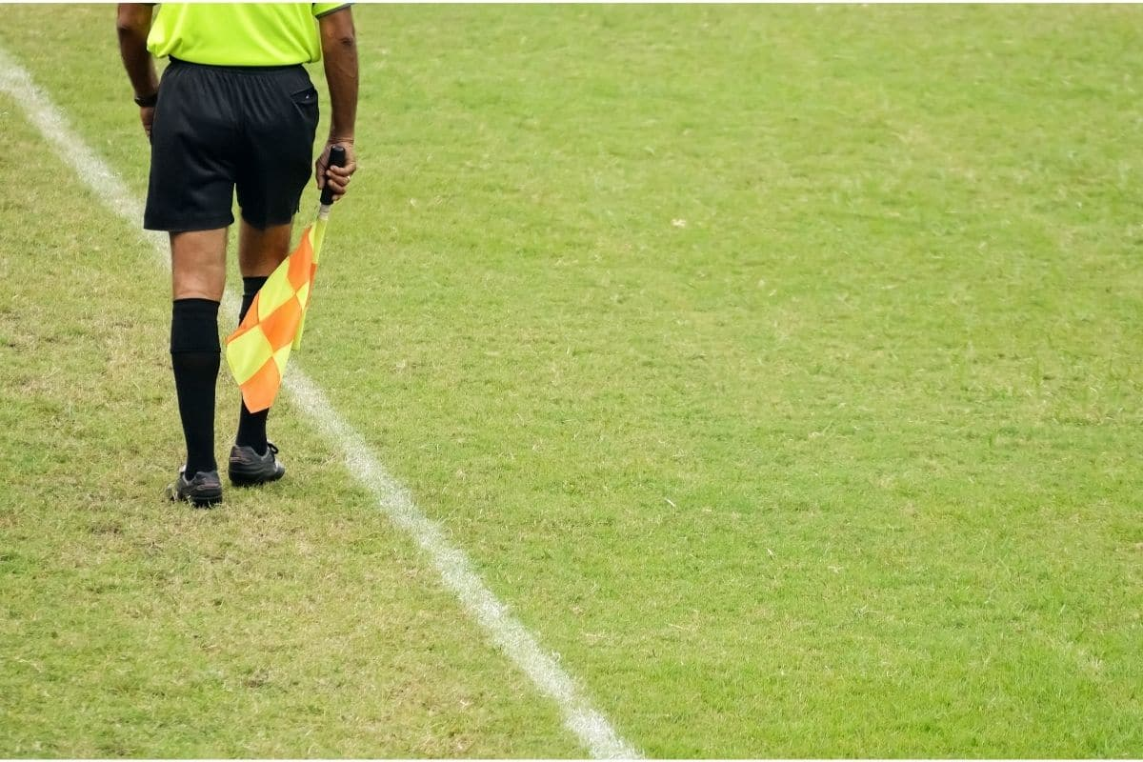
BUSINESS VIABILITY
FIFA’s Semi-Automated Offside Detector
A semi-automated offside technology, utilizing 12 tracking cameras and an IMU sensor inside the ball, aids officials in making faster and more precise offside calls.
Assistant Referees (linesmen)
These officials are positioned on the sidelines and are responsible for judging whether an attacking player is in an offside position when the ball is played.

Slide 5
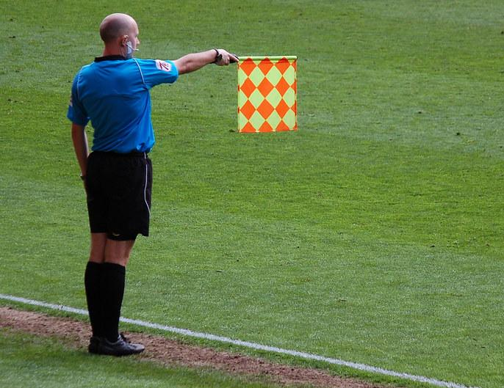
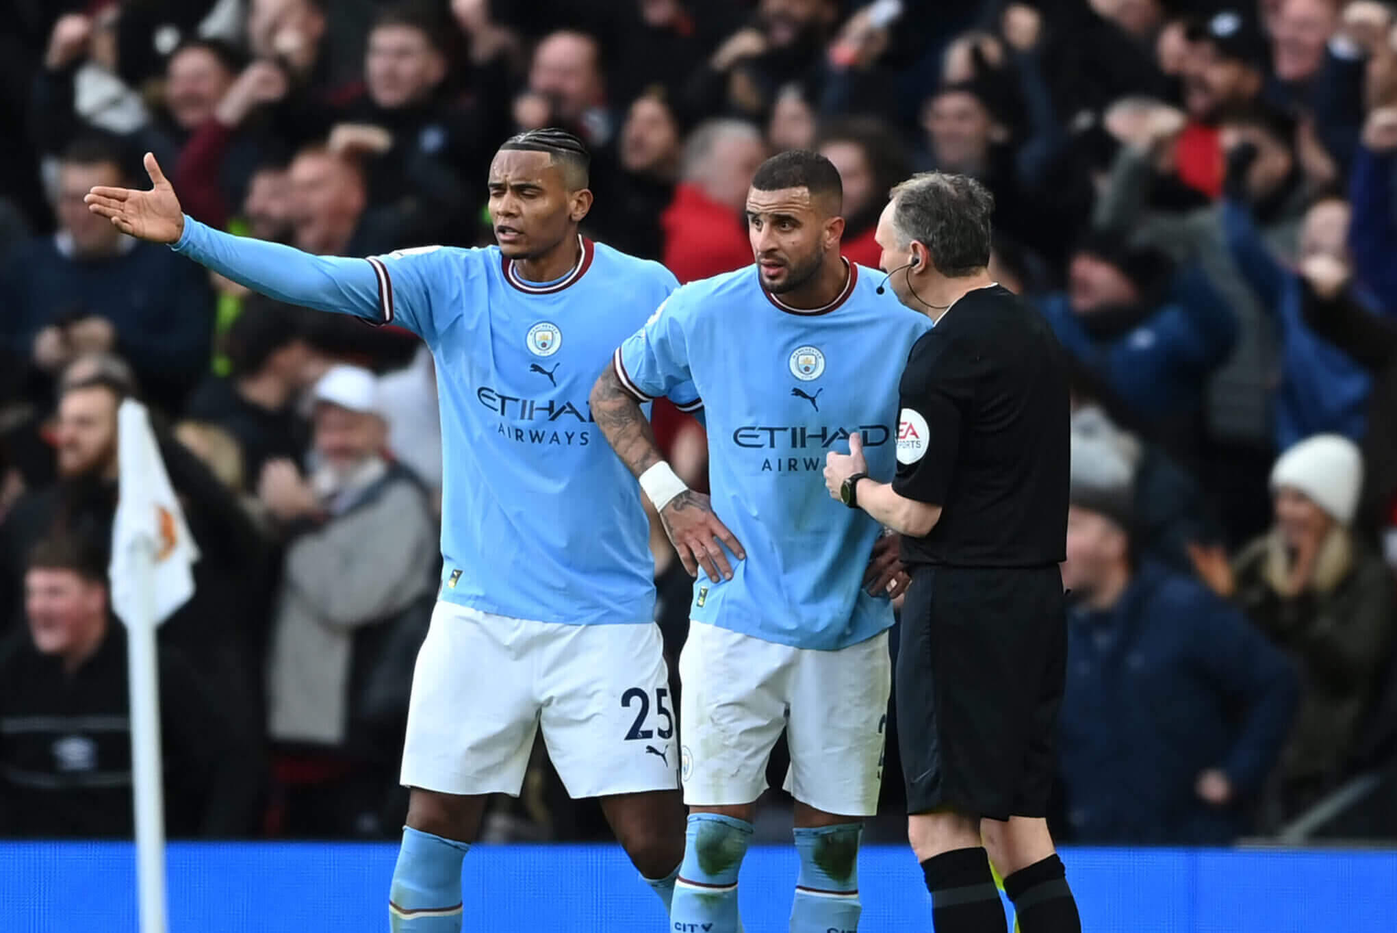
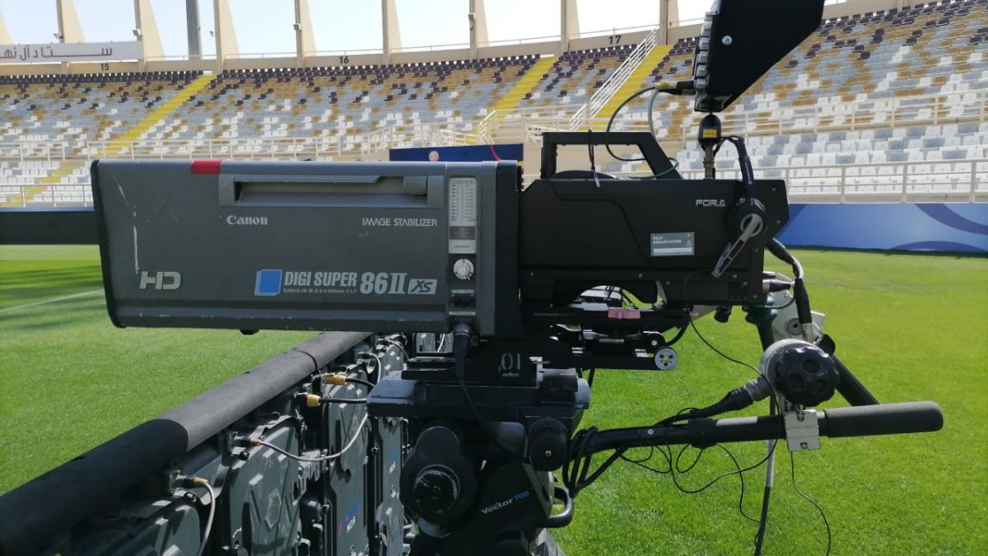
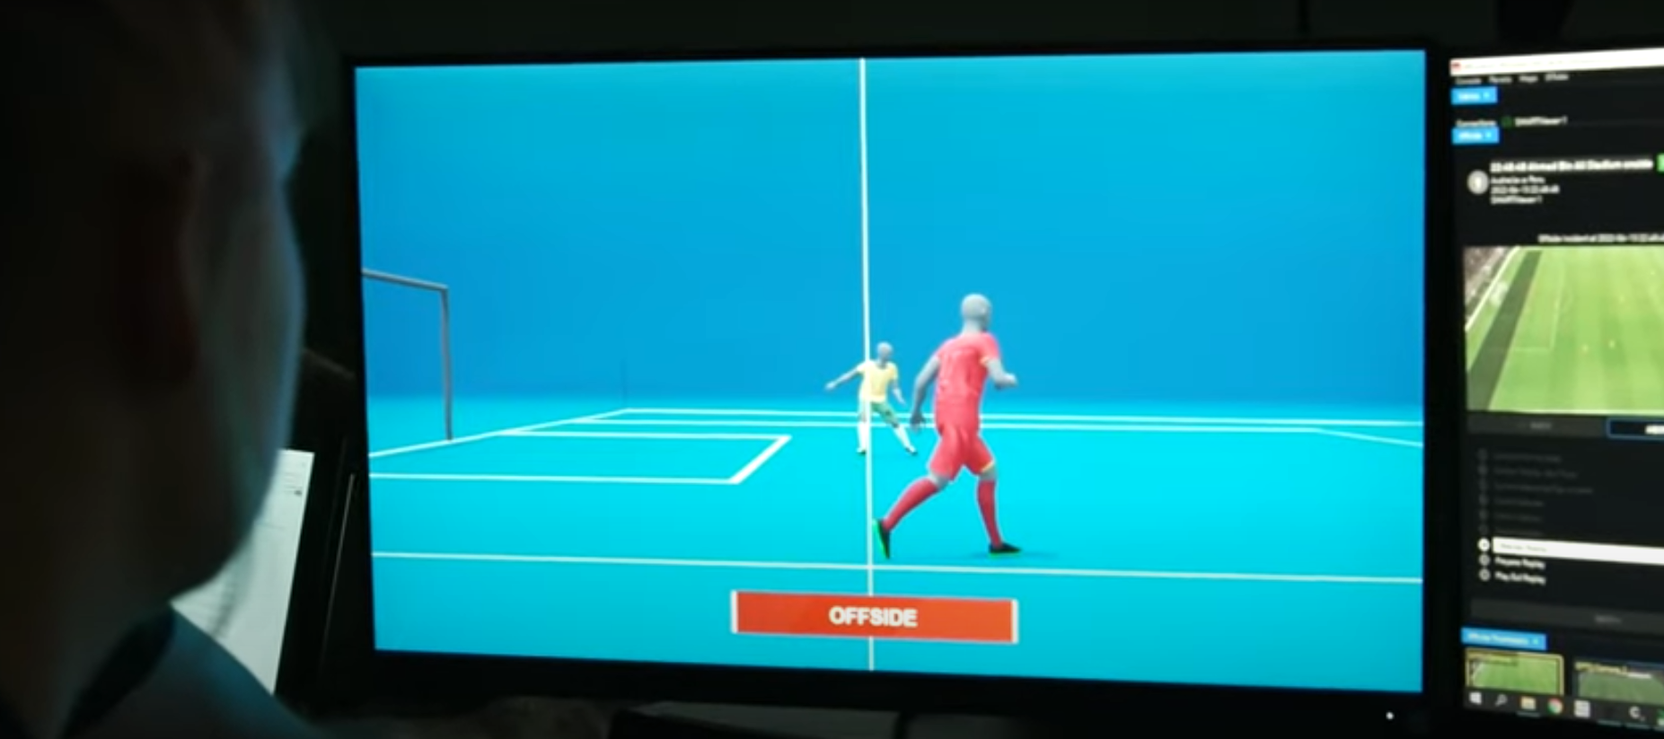
CHALLENGES
Human Error and Subjectivity
Camera Perspectives
Frame Rate and Resolution
Latency
Complex Situations
Speed of Play
Offside Line Calibration
Cost and Accessibility

Slide 6
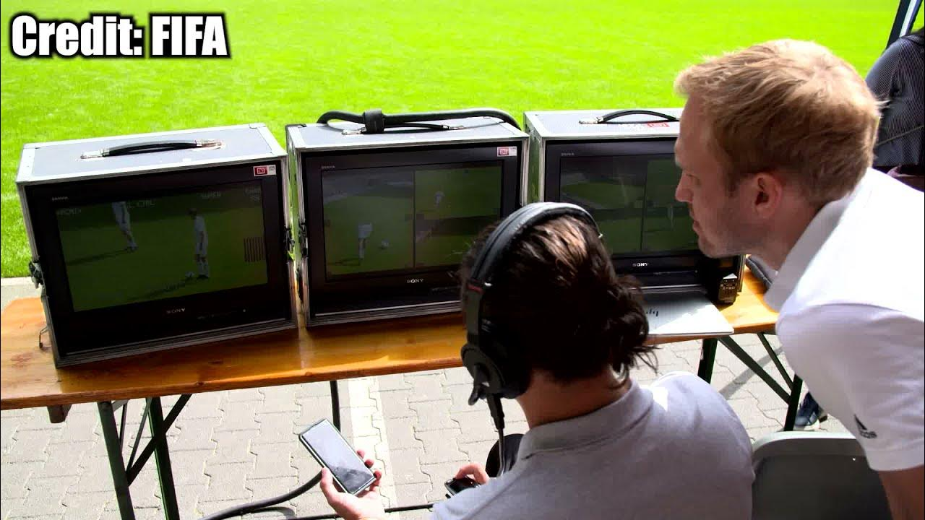
WHY IS OUR SOLUTION BETTER?
FIFA’s Semi-Automated Offside Detector | PitchEye
At least 10-12 specialist cameras | 2-4 normal cameras
‘Limb-tracking’ Technology & 3D Animation | YOLO v8 & Simple Algorithm
Inertial measurement unit sensor | No technical unit needed
A specialized team of at least 5 trained staff | 1 staff
Expensive hardwares | Integrated tool and CPU friendly
NO
What we provide:
Streamlined solution
Low cost and high accessibility
Easy to deploy
Automated Decision Making Suggestions
YES

Slide 7



OUR TARGET AUDIENCE

Slide 8
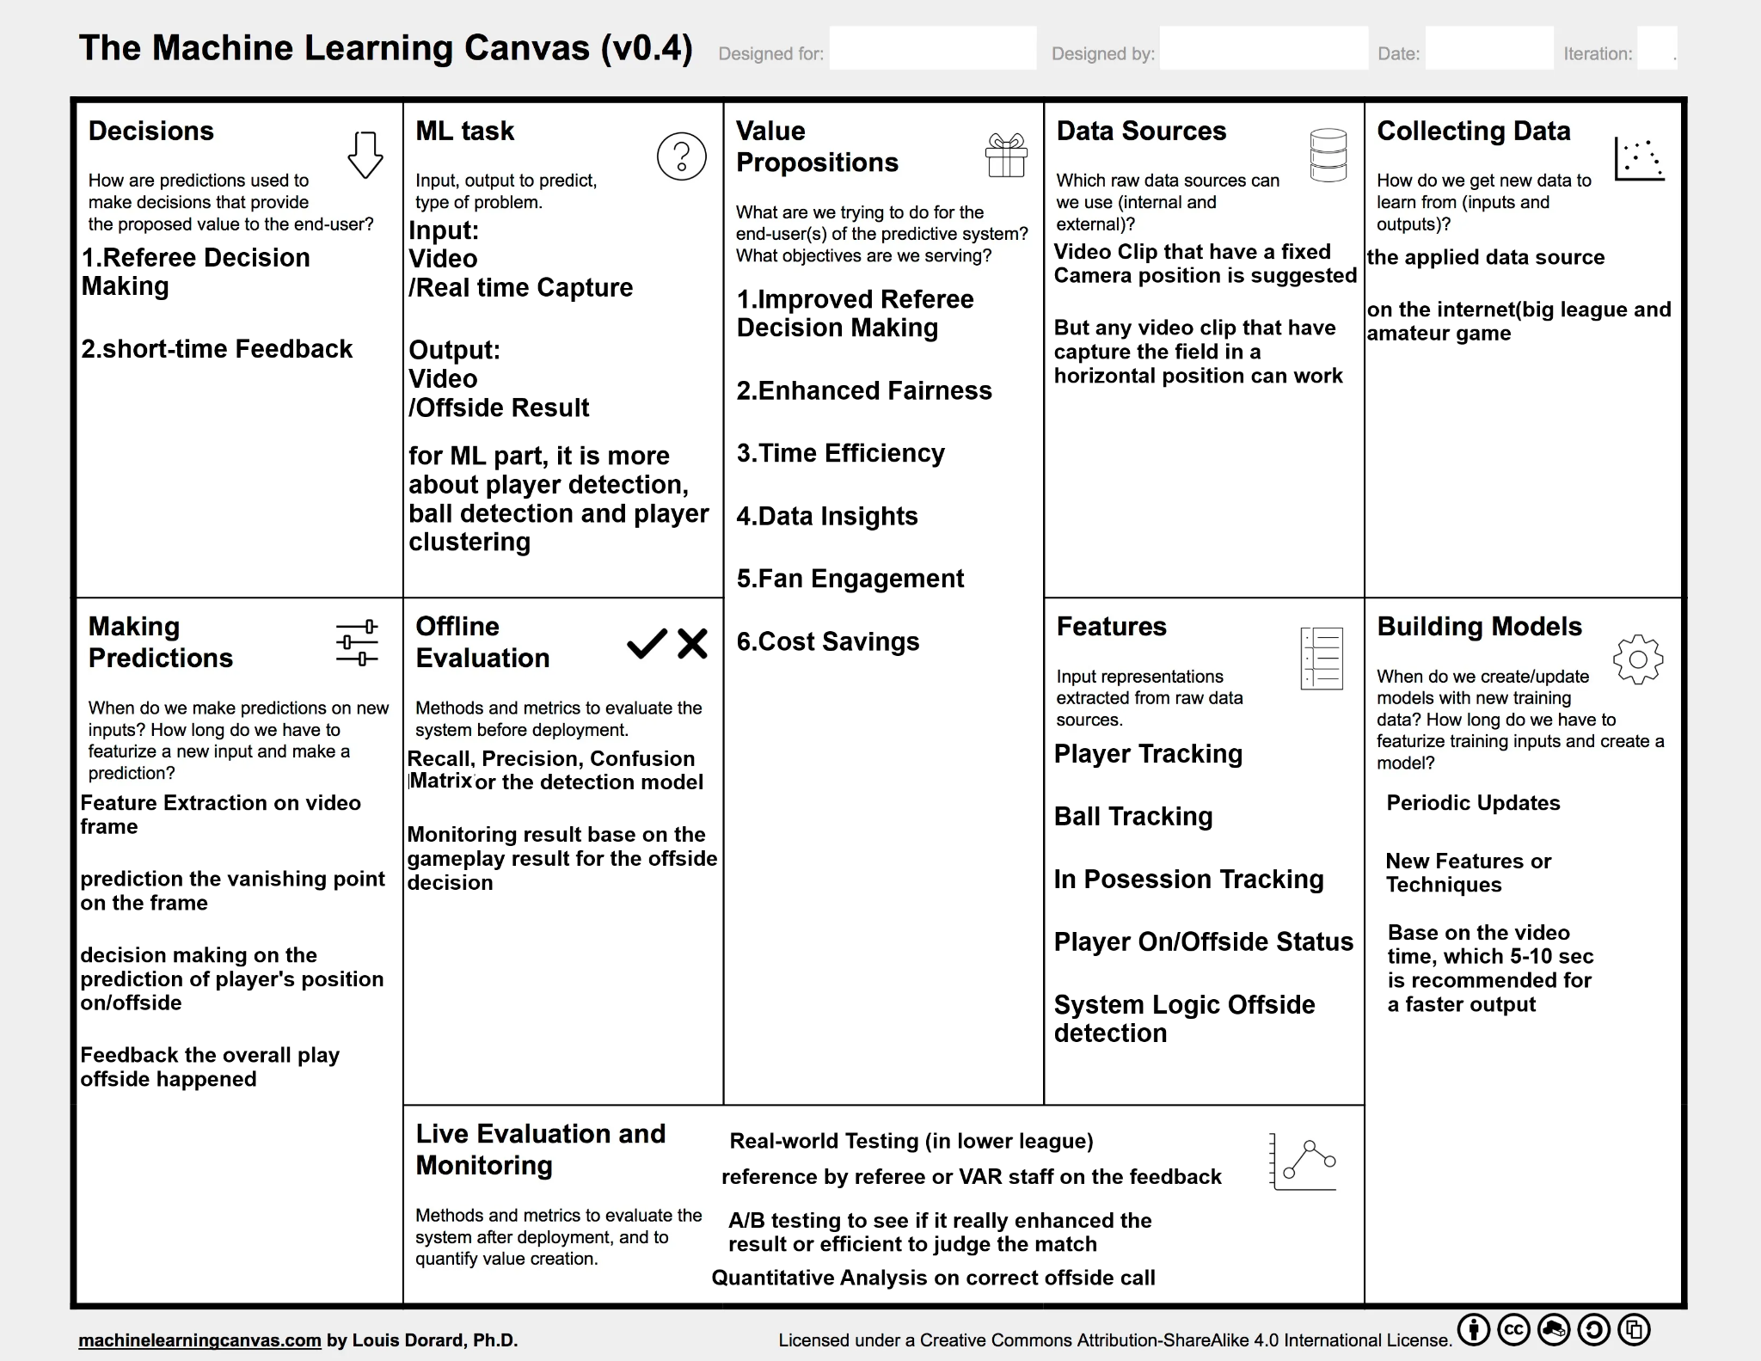
Methodology - ML Canvas
Annotated frames
Live feed from
broadcast camera
inference time
Video writing time

Slide 9
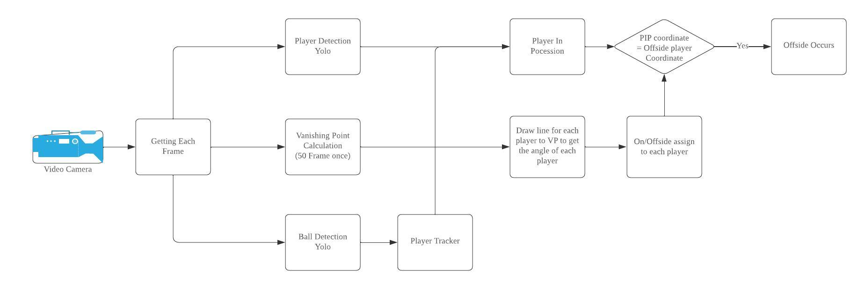
Detection Process

Slide 10
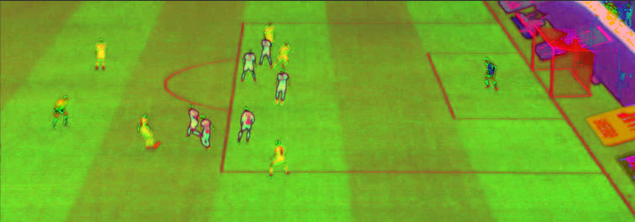
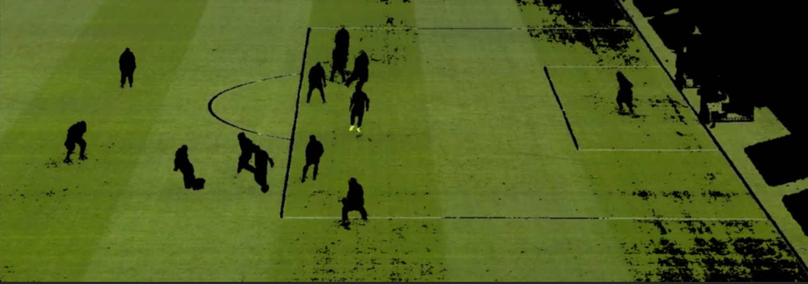
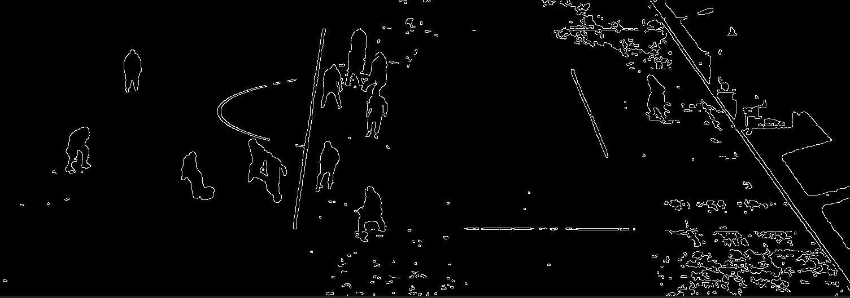
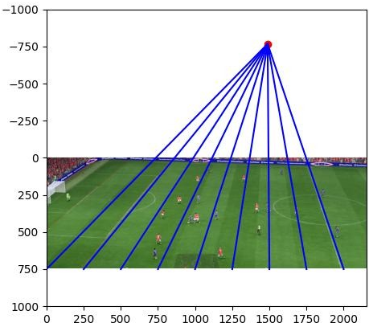
How Offside Calculated
HSV
By determining the vanishing point (VP) within an image, we establish a reference point for determining not only the coordinates but also the real-world positions of objects on the field.
green mask
Given the accuracy of the vanishing point, it's reasonable to assume that coordinates aligned on the same blue line are not only parallel but also correspond to the same x-coordinate in the real world.
Edge
The angle of each line will be calculated, and the line with the minimum angle of the defending team will represent the position of the last defender. If players from the opposing team have smaller angles than the last defender, an offside value is triggered.

Slide 11
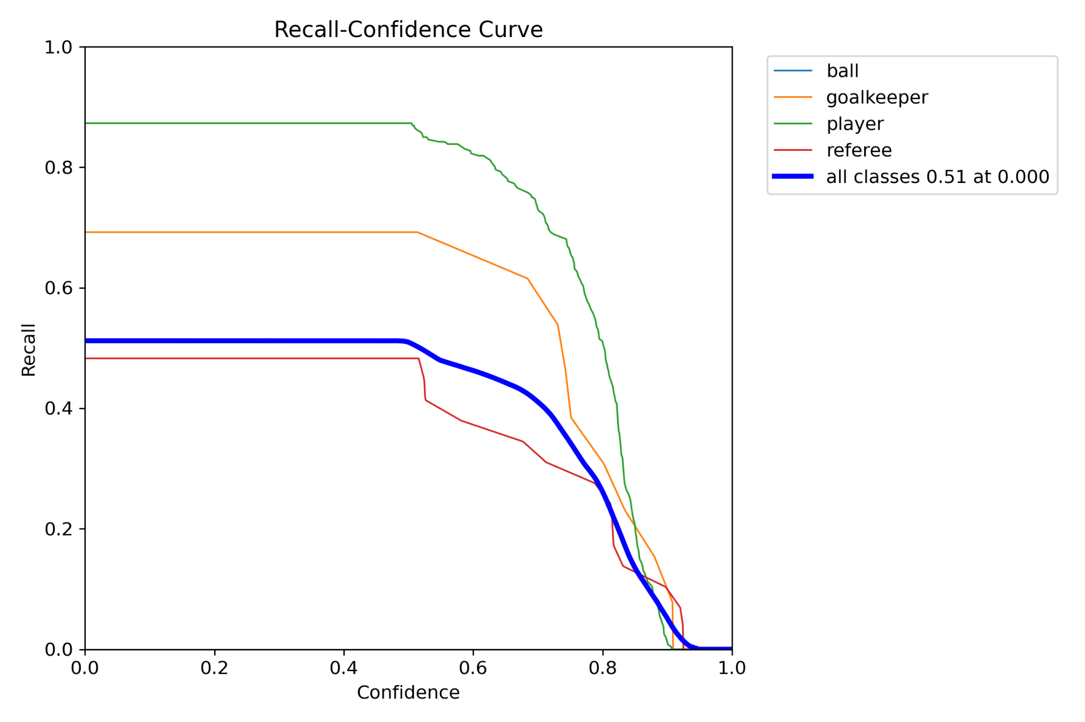
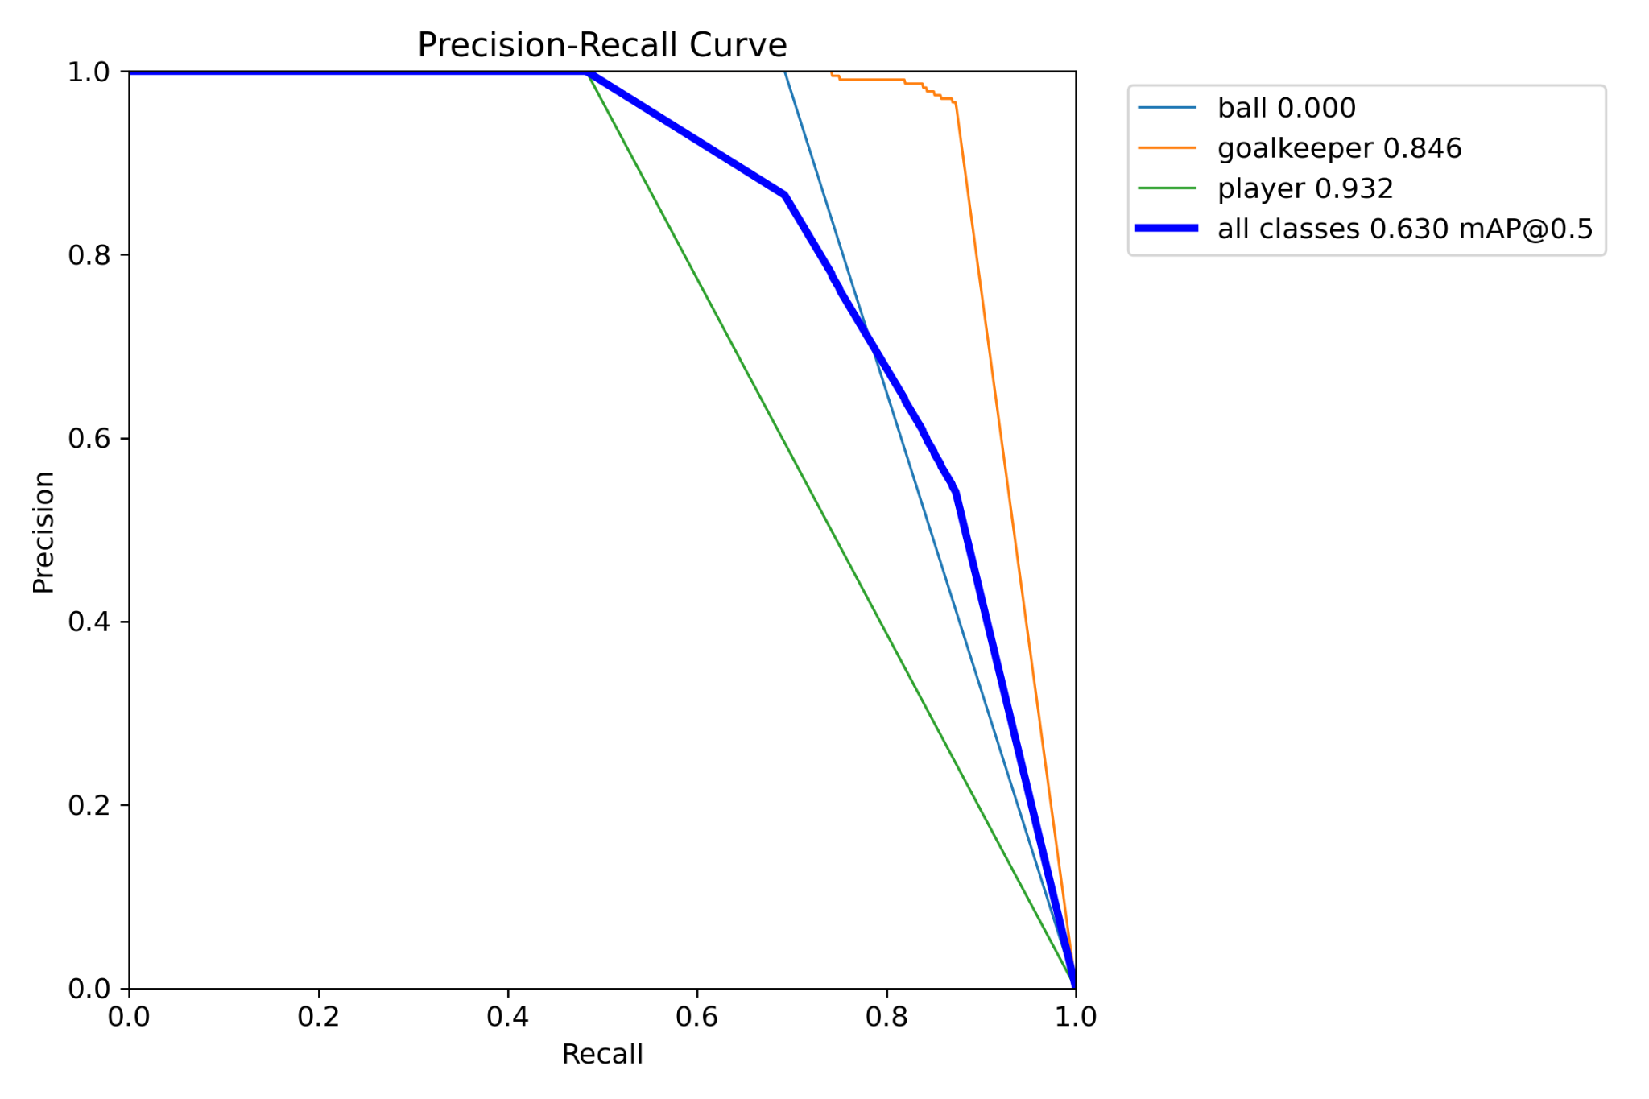
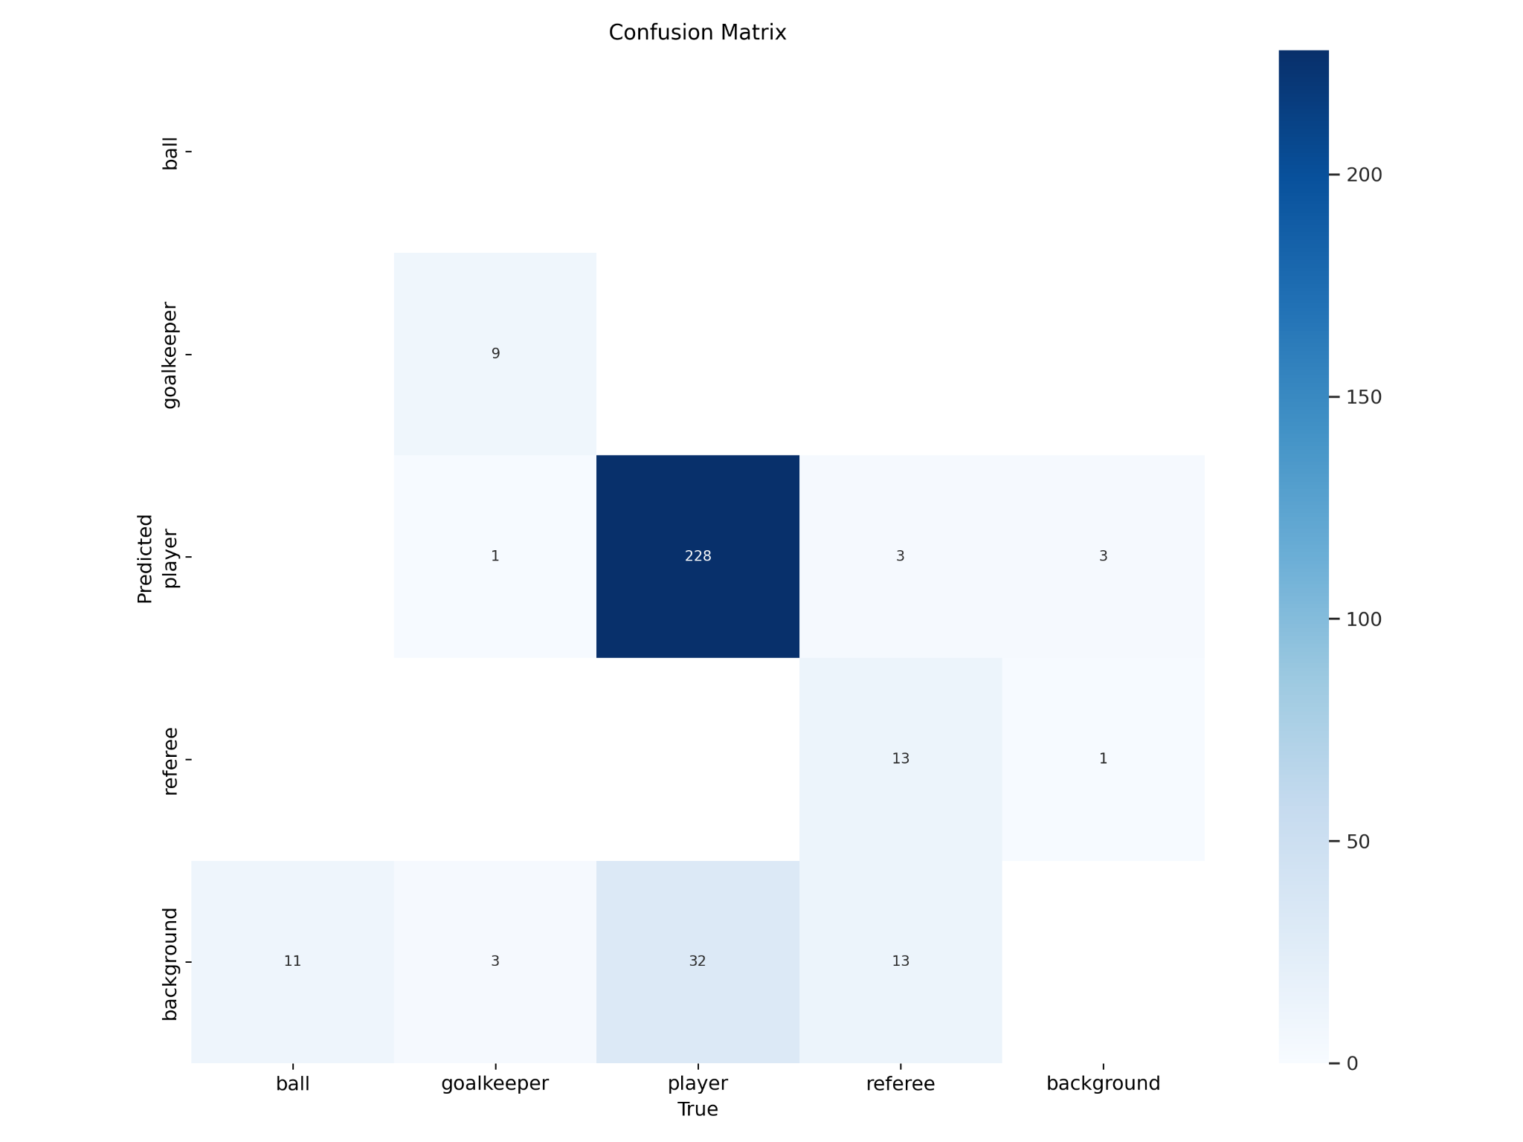
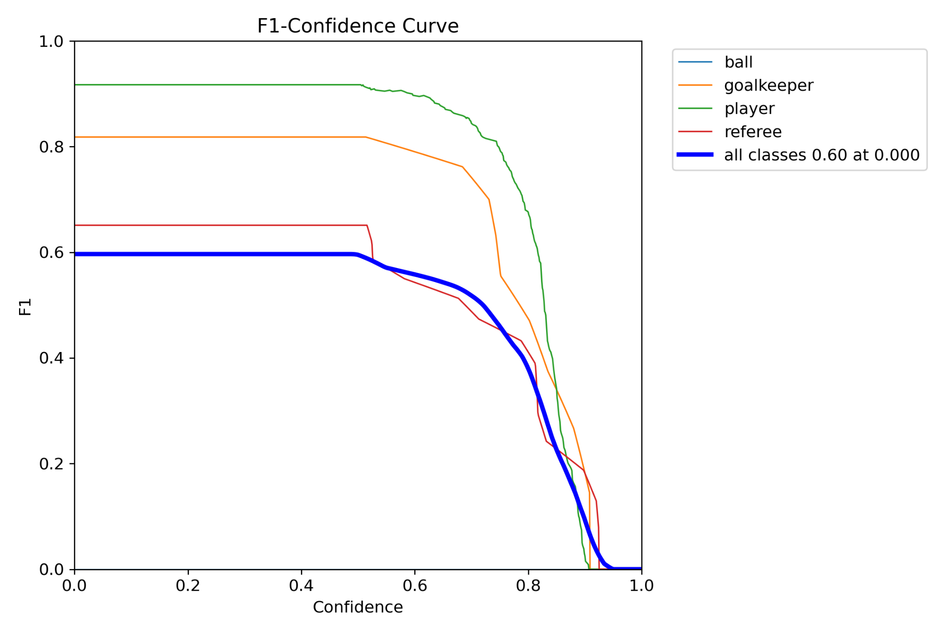
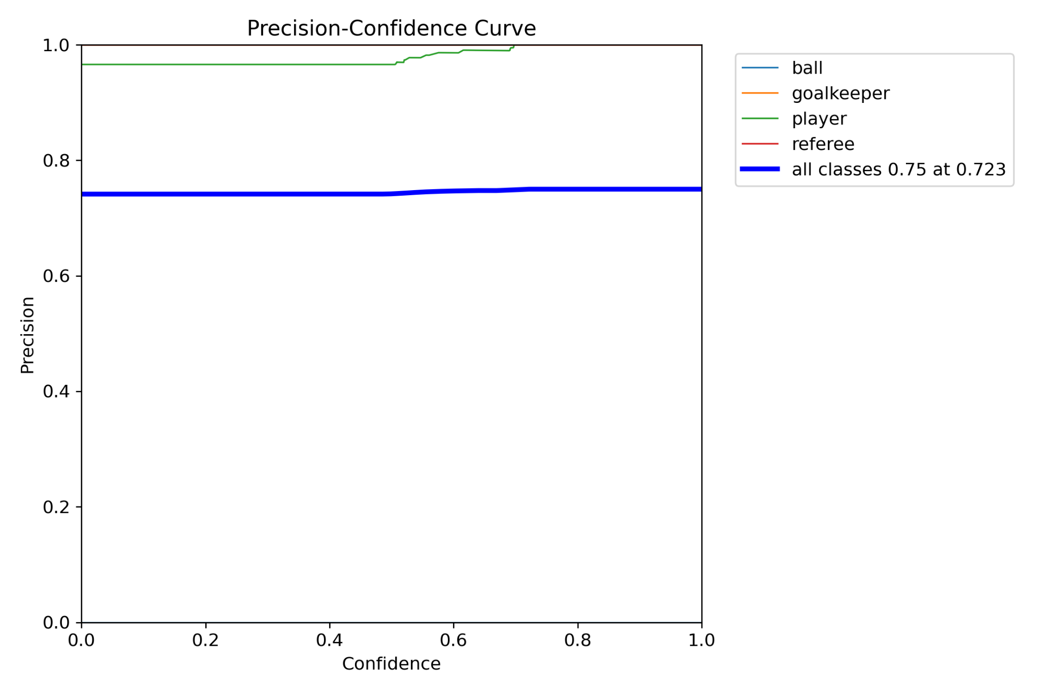
MODEL BENCHMARKING

Slide 12
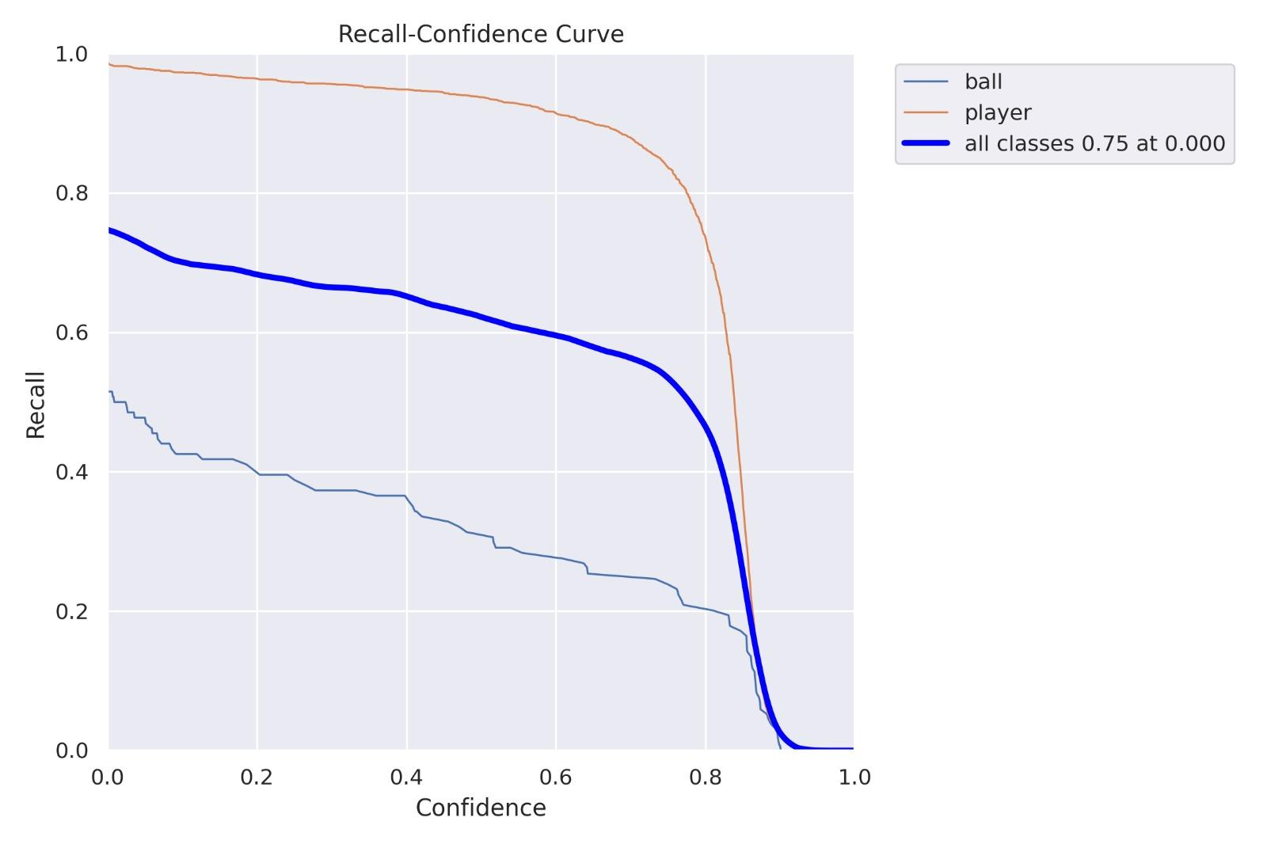
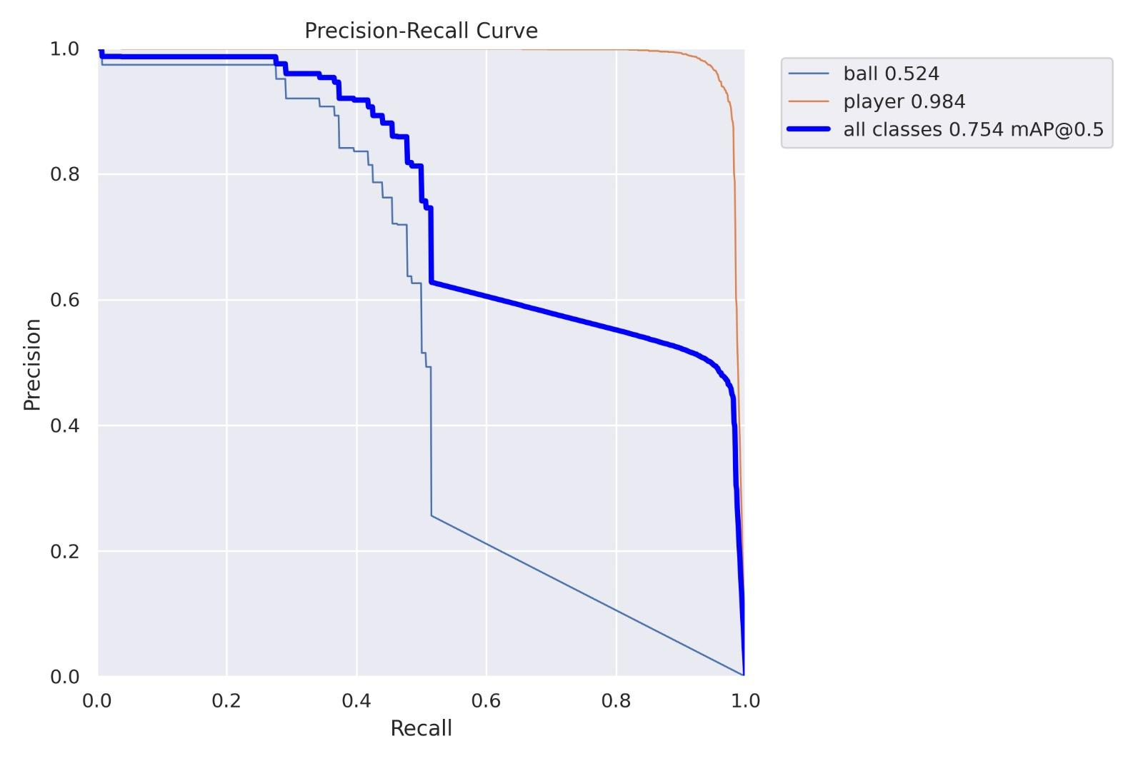
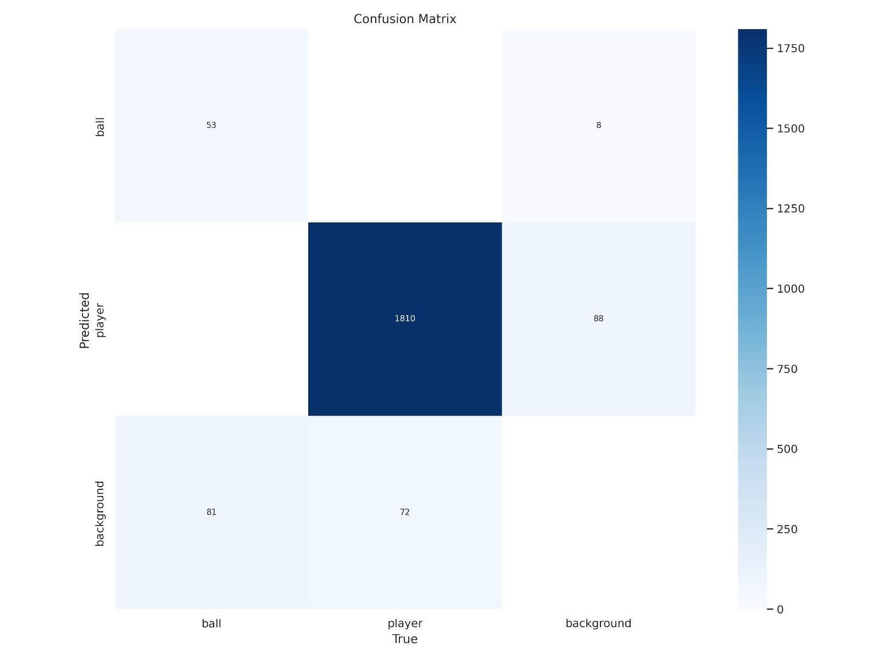
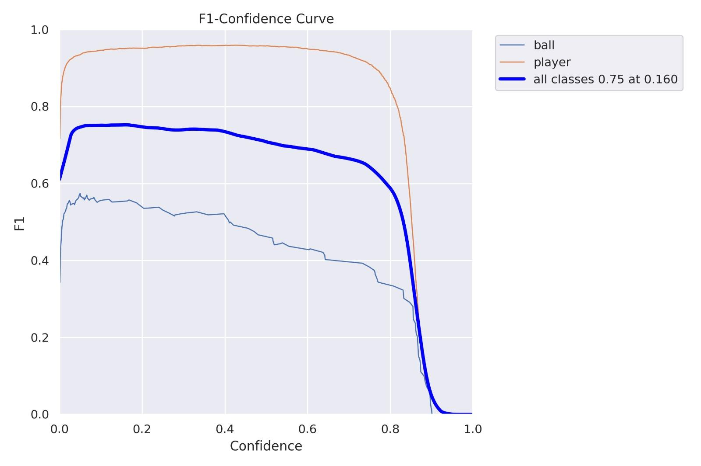
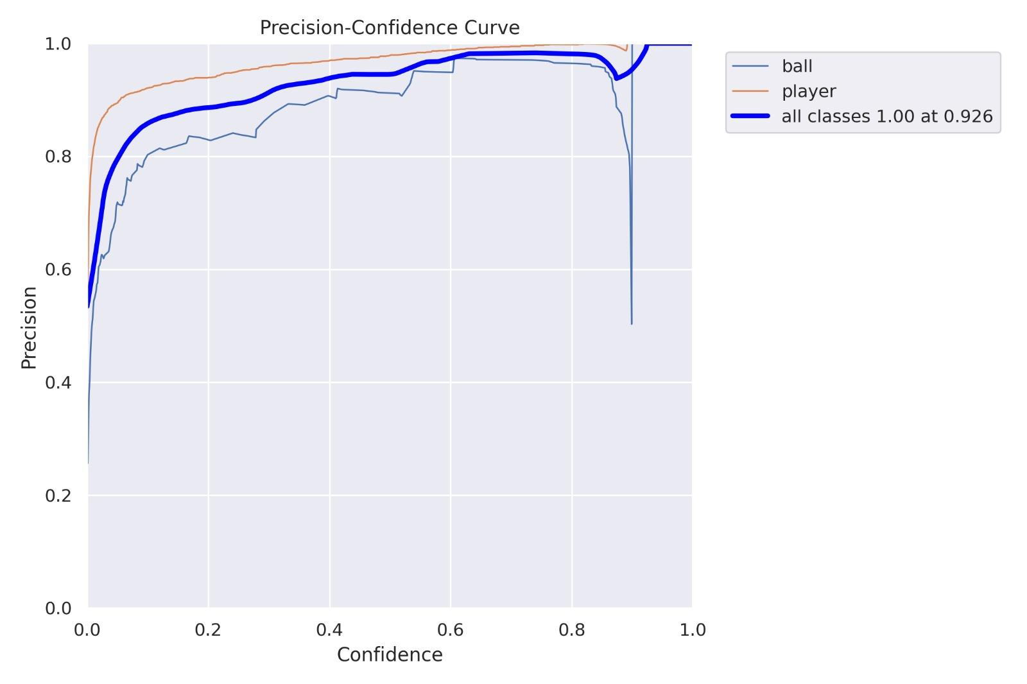
MODEL BENCHMARKING

Slide 13
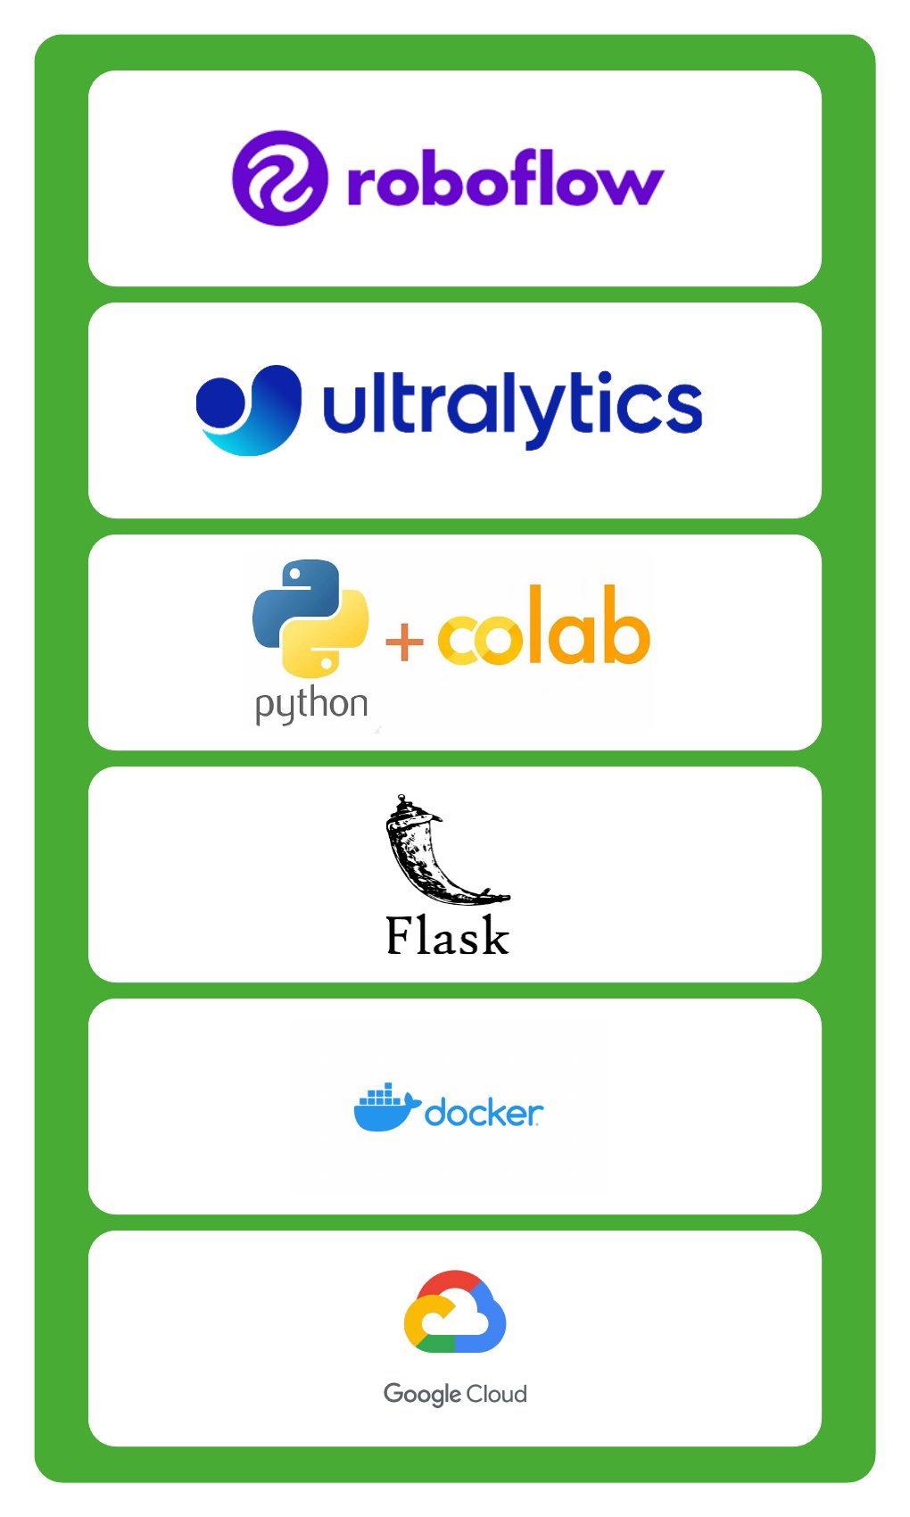
MODEL DEPLOYMENT
Dataset - Augmentation was applied on the annotated dataset using Roboflow’s workspace platform
Model - We leveraged Ultralytics to fine-tuned a pre-trained YOLOv8 model
Training Environment - The model was trained on a host colab runtime leveraging a T4
Flask - We leveraged Flask to create our web application scripting our code with an Object Oriented Methodology
Docker - We created a docker image and pushed that image into our Docker Hub repository.
Virtual Machine - We created a virtual machine instance using GCP which hosted our docker.

Slide 14
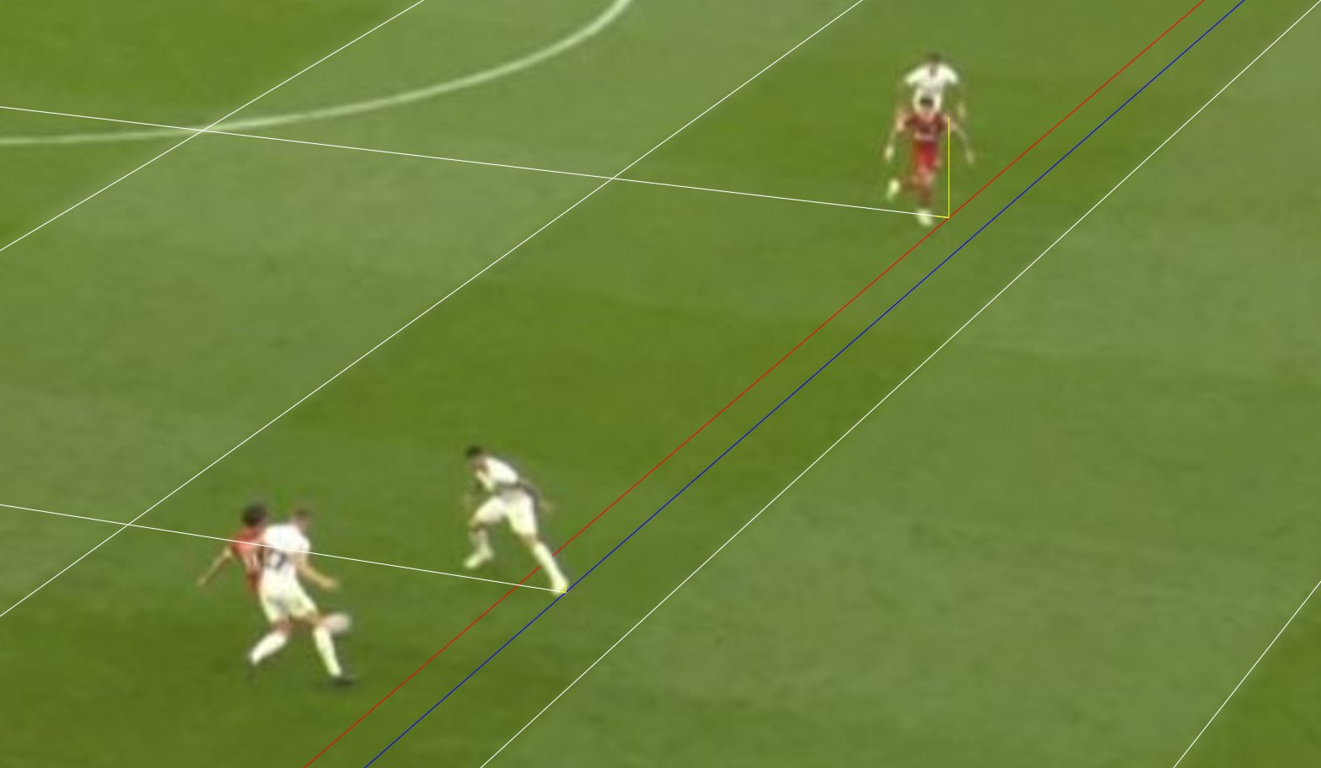
Improvement and Challenges
Enhancing the stability of models in clustering and skeleton detection is crucial for incorporating additional logic into offside and ball kicking detections.
1
Utilizing separate video recordings from different angles for the detection process, rather than consolidating them into one.
2
Designing adaptive noise reduction algorithms specifically tailored to various video sources to minimize errors in calculating the vanishing point.
3

Slide 15
DEMO

